Slide 1


Safe environment for children and youth: from a protection to a development perspective
Unpacking Children and Young People’s Participation in Promoting a Safe Environment
Caux, Switzerland
28 July 2013
Maria Lucia Uribe
Director, Arigatou International - Geneva
Notes:
This presentation will address safety not only from a protection point of view but from a development stand and will argue that by creating a safe environment for children that considers not only their physical and emotional safety but also their environment, cognitive and spiritual safety, children are empowered to fully participate in society and help transforming the many issues that affect them.

Slide 2
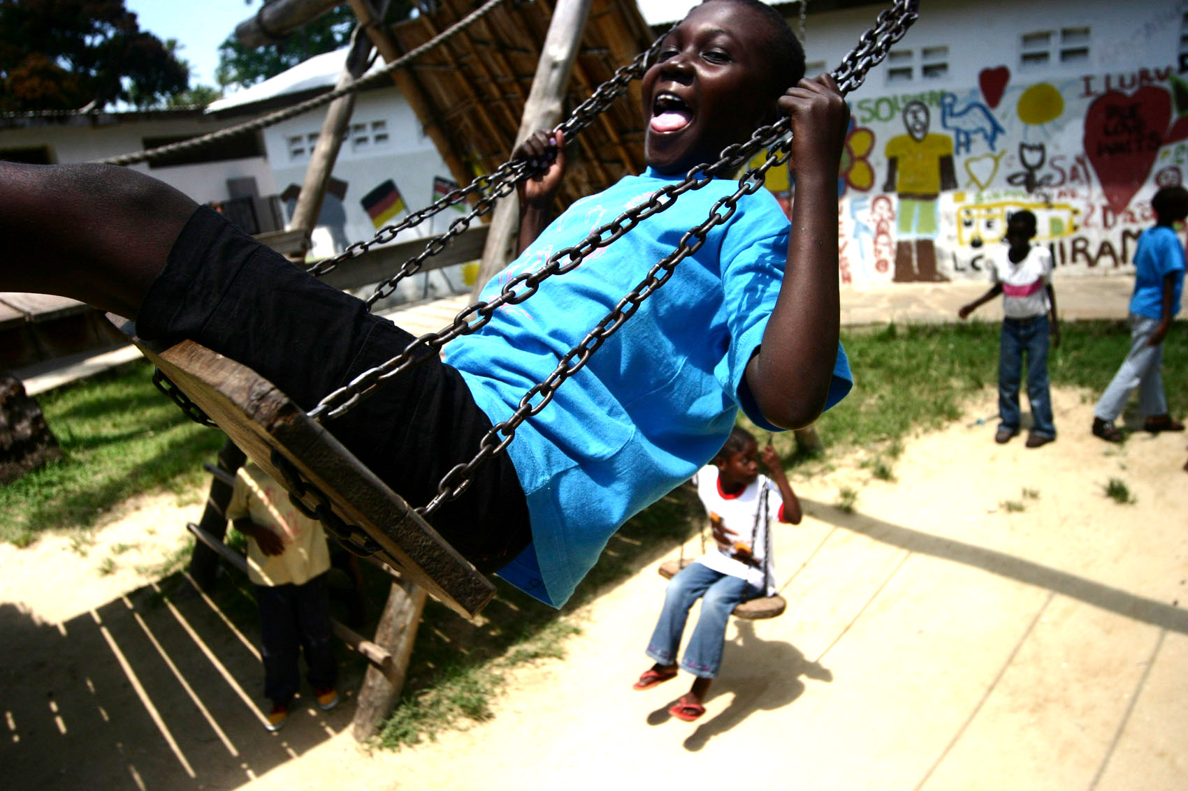
Human Dignity
Learning to Live Together
Human life is sacred
Fulfillment of basic necessities
Capacity to choose and make decisions freely
Develop identity
© Stacy Hughes
Notes:
When we talk about children and young people – there is a central element that should frame all our discussions, interventions and reflections – human dignity. It is an umbrella concept for the Convention on the Rights of the Child, it is also a core element in many religious communities and a central component for the development of justice and peace. I want to start my intervention by framing the key areas of this panel: children, young people, participation, safe environment, around the understanding of human dignity. If we want to provide a safe environment for children and young people and want to empower them as agents of change, we need to look more holistically at the topic and from a more integrated perspective.

Slide 3
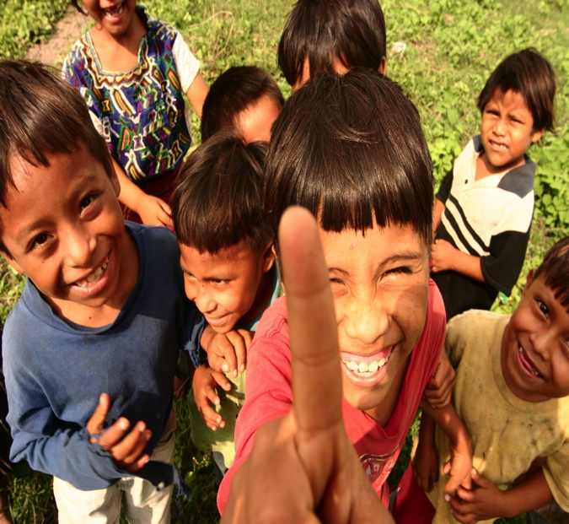
Safety – Protection perspective
Learning to Live Together
Safety – From Protection to Development Perspective
Physical
Emotional
Environmental
Cognitive
Spiritual
© Stacy Hughes
Notes:
What is safety?
The dictionary describes safety as “the condition of being protected from or unlikely to cause danger, risk, or injury”. Oxford Dictionary
Safe: protected from or not exposed to danger or risk; not likely to be harmed or lost.
- Safety in these terms places children into an object perspective and dynamic. “We need to protect children” we may think. But what does it mean? How do we create a safe environment that allows them to develop freely and fully?
Every child and young person has the right to a safe environment. The UN Convention on the Rights of the Child states that the child must have the opportunity of growing up and developing in an environment that is as healthy and safe as possible and that the child’s parents should be provided information on, for example, injury prevention.
When we talk about creating a safe environment we mostly hear protection of children against physical harm, direct violence, abuse and exploitation. It encompasses in many cases, though not often, the emotional protection of children. Art. 2 of the CRD talks about the importance of creating safe and protective channels for participation and self-expression. Safety and protection also encompasses environmental protection – though most of the times it fails to address safety of children from a development perspective. How do we ensure that children are and feel safe o develop their talents, to develop their identity, to participate, to relate to others, to transform the world? We need to address safety at physical, emotional, environmental, cognitive and spiritual levels. A safe environment for children encompasses several levels.

Slide 4
Safety – From Protection to a Development perspective
Learning to Live Together
Physical and verbal mal/mistreatment and abuse
Direct violence
Structural violence
Cultural violence
* Johan Galtung
Inequalities, injustices, environmental degradation
Indoctrination, manipulation, conditioning
Notes:
Protection and development sometimes seems compartmentalized.
To understand what it means to consider safety from a development perspective, it is important to understand different types of violence – direct, structural and cultural. Most of the times safety is understood from the direct violence point of view: physical and verbal mal/mistreatment and abuse, however, if there are inequalities, injustices, if children cannot access social services, if they are discriminated against, they are not safe to develop their full potential and their human dignity is violated. There is another type of violence that is even more important when it comes to the safe development of children and it is cultural violence – are children manipulated to speak or express their views, or even not allowed to express their opinions? Are children indoctrinated about particular views or beliefs and not allowed to critically think about their own lives? Are children not provided opportunities to explore diversity, different views, and conditioned to accept the status quo? How can children grow safely if they are not encouraged to thrive and fully develop their capacities?

Slide 5
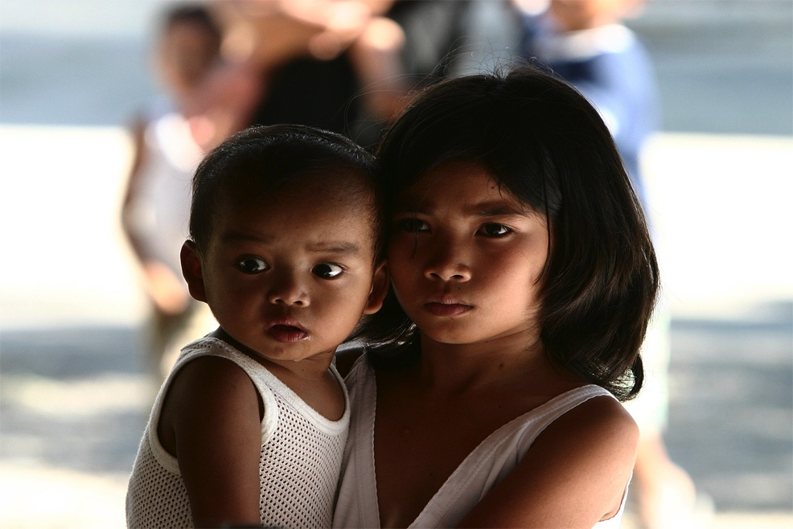
Physical safety – threatened by
Learning to Live Together
Child labor
Sexual exploitation/abuse
Child trafficking
Recruitment child soldiers
Corporal Punishment
Child marriage
© Stacy Hughes
Notes:
Let us briefly look at the threats to the safe development of children
These are some of the threats to the physical protection and development of children.
Almost 50 million primary- and lower-secondary-age children are out of school
in conflict-affected countries. Of these, 28.5 million are primary-age; more than half of them are girls. The proportion of out-of-school children in conflict- affected countries has increased from 42% of the global total in 2008 to 50% in 2011 – Save the Children
THERE ARE ESTIMATED TO BE 250,000 CHILD SOLDIERS IN THE WORLD. 40% OF CHILD SOLDIERS ARE GIRLS – War child
14 million girls under the age of 18 marry each year. - See more at: http://www.plan-uk.org/early-and-forced-marriage/#sthash.UImpsjRd.dpuf
UNICEF estimates that around 150 million children aged 5-14 in developing countries, about 16 per cent of all children in this age group, are involved in child labour
About 29,000 children under the age of five – 21 each minute – die every day, mainly from preventable causes.
Negligence -

Slide 6
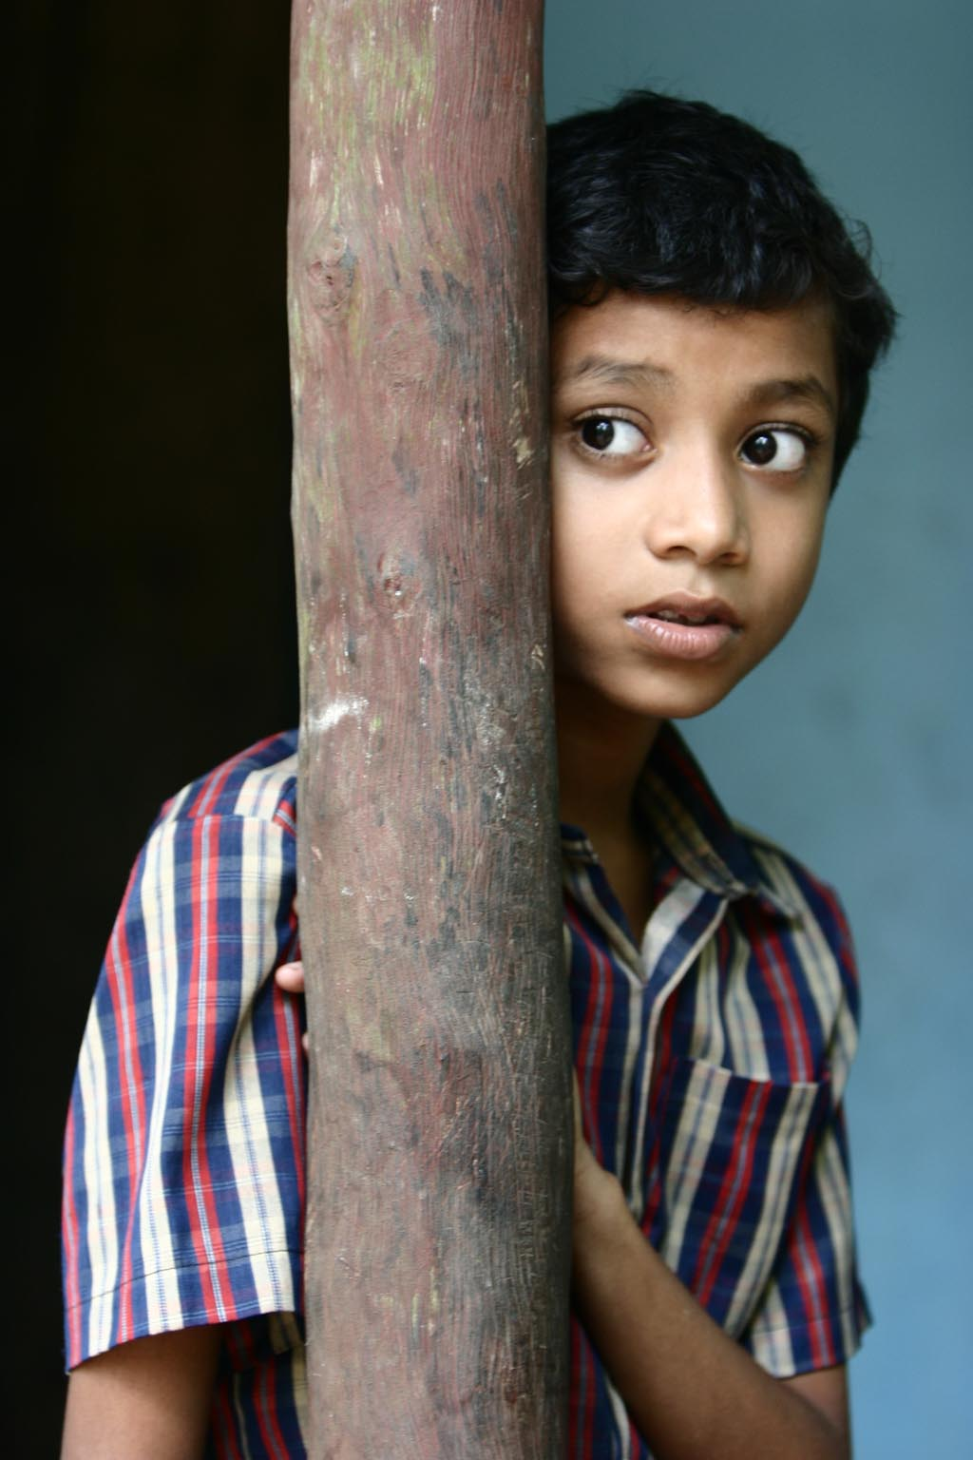
Emotional safety – threatened by
Learning to Live Together
Verbal abuse
Isolation
Discrimination
Bullying
Exclusion
Vertical relationships
Manipulation
© Stacy Hughes
Notes:
Verbal abuse: humiliation, intimidation,
Vertical relationships: creating gaps between children, youth and adults – hierarchies,
Manipulation: to marry, to work, to join illegal armed groups, but also to belief what we want them to believe, to avoid that they make their own thoughts and opinions
Isolation: separation from friends
Discrimination: based on status, beliefs, expressed opinions, activities, sexual orientation

Slide 7
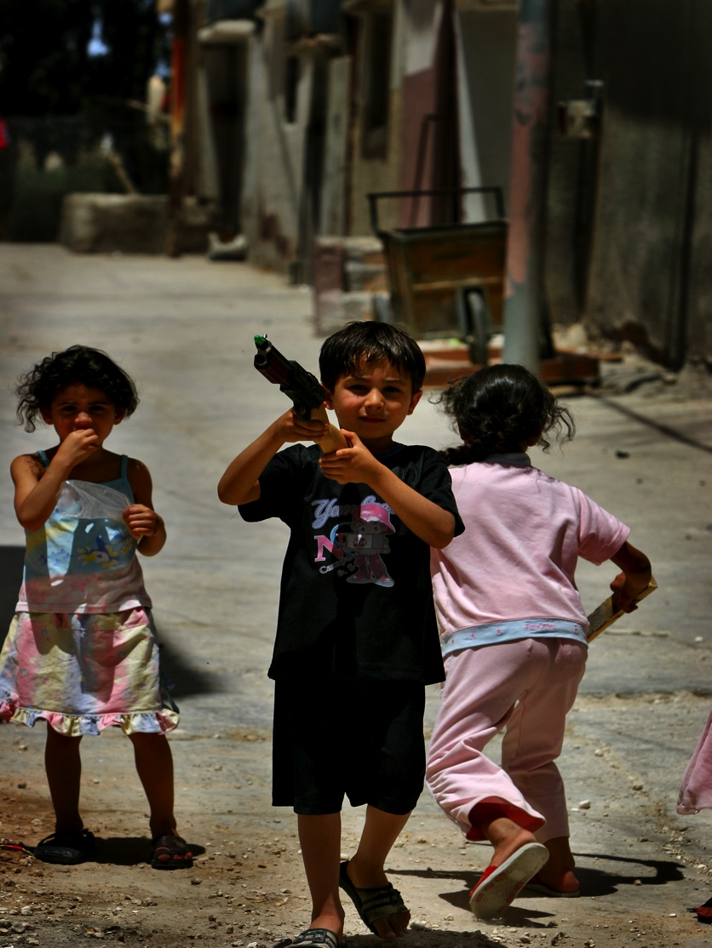
Environmental safety – threatened by
Learning to Live Together
No proper construction of schools
Unavailability of washing facilities
Attacks - conflicts
Natural disasters
Environmental hazards
Poverty - inequalities
© Stacy Hughes
Notes:
Based on UN data, we estimate that there were more than 3,600 separate, documented attacks on education in 2012.3
Poverty is clearly a threat on safety of children – which is rarely addressed in child programming though it is highly included in development programs. What causes poverty? Inequalities, injustices, corruption, how are those being considered when developing child and youth programs? How do they hamper children’s participation and the possibility to live in a safe environment? How do injustices and corruption also influence the way children see the world or become part of the world?

Slide 8
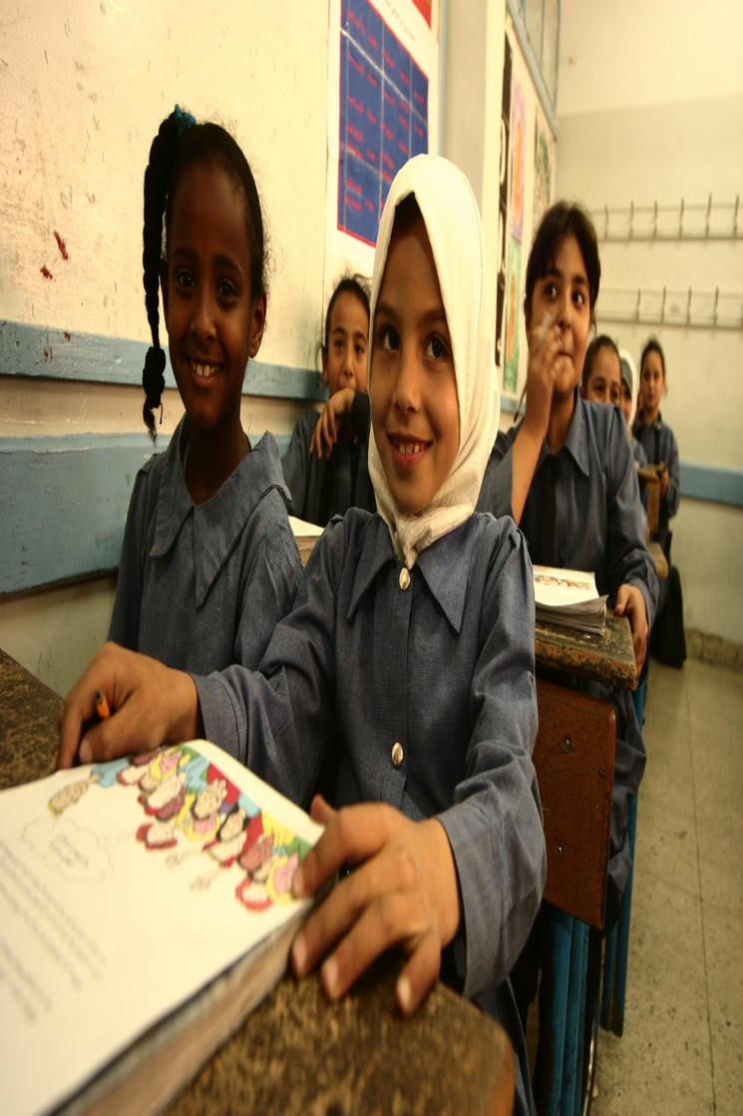
Cognitive safety – threatened by
Learning to Live Together
Malnutrition
Inadequate stimulation of learning opportunities
Indoctrination
© Stacy Hughes
Notes:
Capacity of children to acquire knowledge, develop skills and capacities, and most importantly to be able to understand and comprehend concepts and situations. How do we create the possibility for critical thinking? How do we allow children to learn to make decisions? How do we allow a safe space for children to be creative, to develop problem solving skills and apply those in their environment? How do we avoid indoctrinating our children into particular opinions and beliefs without allowing them the space to understand and critically think about those? Is this a safe learning?

Slide 9
Spiritual safety – threatened by
Learning to Live Together
Lack of spaces for silence and reflection
No opportunities for children to practice their own religion
No space for possibilities
No emphasis on self-expression and for questioning
No priority to the arts, nature, sports
No encouragement or time for dialogue
Absence of Role modeling
Notes:
More often than not we attempt to kill children’s innate spirituality by punishing them, by boxing them in the way we want them to be, by forcing them to the immediate rather tan to the ultimate.
Importance of Embracing answers – not need to provide all questions,
Possibility to wonder, and to be amazed by the world
Space for children to have possibilities and to find possibilities – to open to other options and get out of the boundaries we impose in them

Slide 10
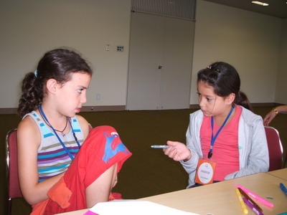
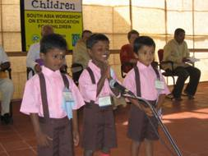
Spiritual safety
Learning to Live Together
© Arigatou International

Slide 11
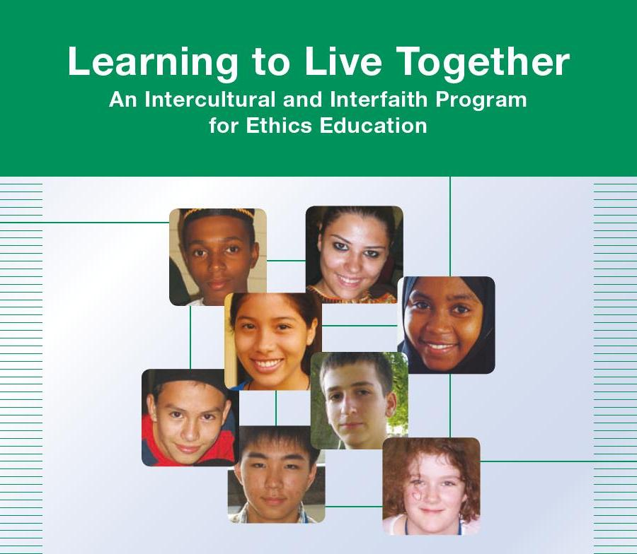
Learning to Live Together
Learning to Live Together
An intercultural and interfaith programme for ethics education
Educational manual with tools and resources for educators
A pedagogical approach to learning

Slide 12
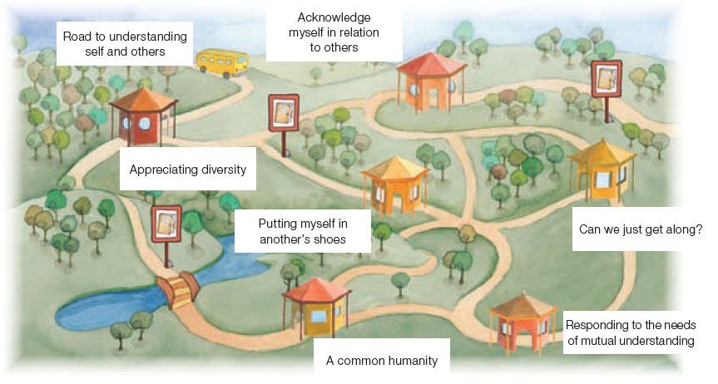
Learning to Live Together
Learning to Live Together

Slide 13
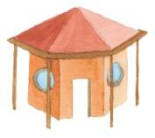
Safe learning environment
Learning to Live Together
Control of their own learning
Trust
Encouragement
Dialogue
Develop themselves
Get to know themselves and others
Cooperation and collaboration
Notes:
Through the creation of a safe learning environment, Arigatou International addresses physical, emotional, cognitive and spiritual safety.
Reflection opportunities
Meta-cognitive skills
Self-journey
Critical thinking
Ethical dilemmas
Problem solving
Collaborative learning
Appreciating diversity
Respecting other beliefs
Transformational – from reflection to action

Slide 14
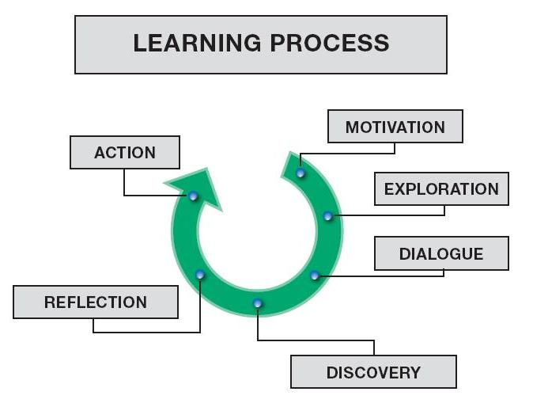
Safe learning environment
Learning to Live Together
Notes:
Learning to Live Together approach and methodologies allow to develop a safe learning environment for children where they can develop fully – going beyond the protection stand point: It allows them to develop their sense of belonging, of being, of connecting with others, of becoming who they want to become and help transforming their societies.
The next slides show how through the Learning to Live Together program those spaces are provided, encouraging children to participate and through participation helping to develop a safe environment for others.

Slide 15
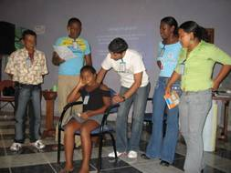
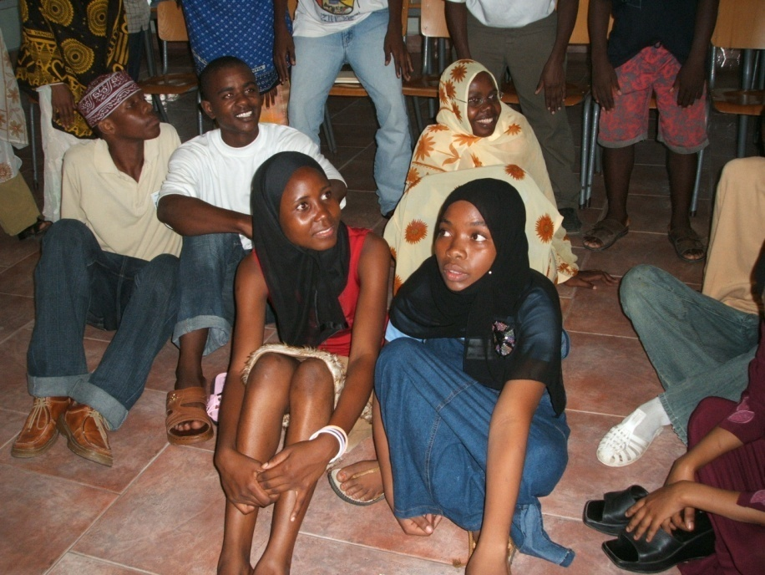
Ecuador and Tanzania - Belonging
Learning to Live Together
© Arigatou International
Notes:
Belonging: Allowing space for children and youth to discover where they belong to, their roots in relation to their experiences and others.
Children from Colombia and Ecuador living in San Lorenzo in the border between both countries – affected by poverty and violence.
Children challenge their views of the other and the notion of where they belong to. Acceptance and recognition of who they are and who the other is overcoming their stereotypes and prejudices.

Slide 16
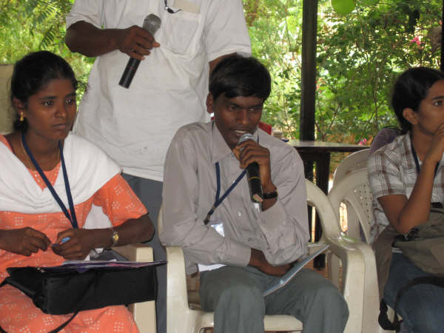
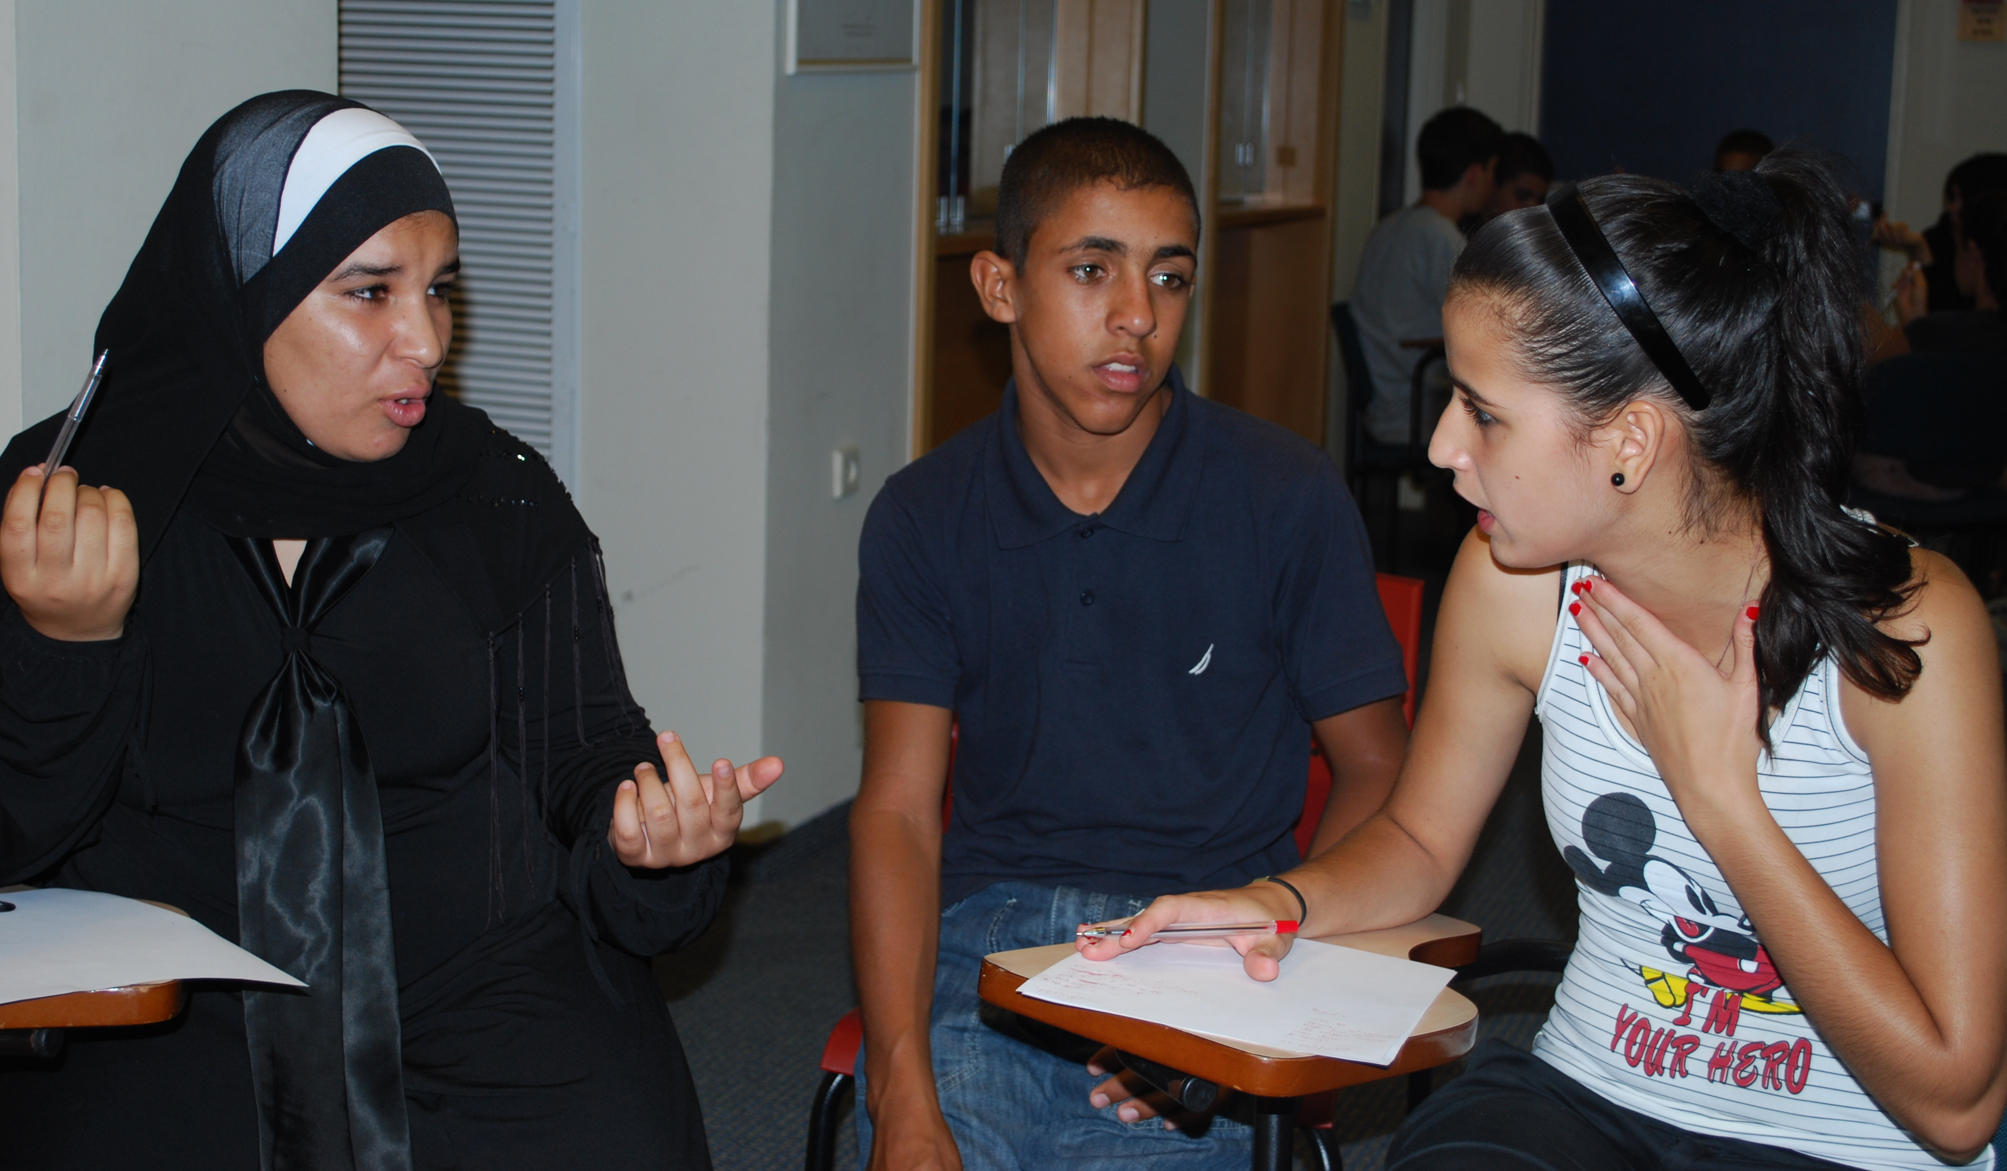
Being
Learning to Live Together
Notes:
Being: Possibility to reflect on what their values are, what they stand for, to express themselves freely,
Being children but also full participants in society – possibility to be part of decisions, to make their voices heard.

Slide 17
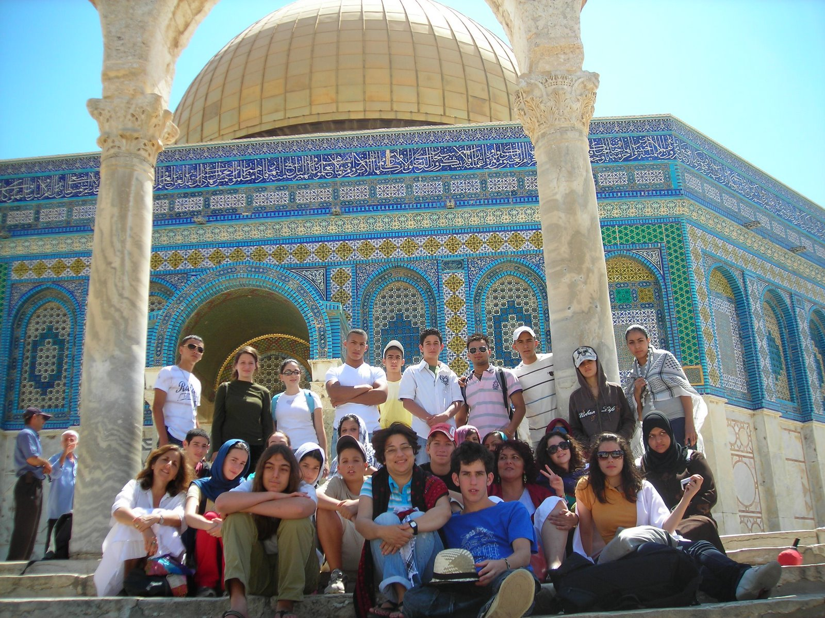
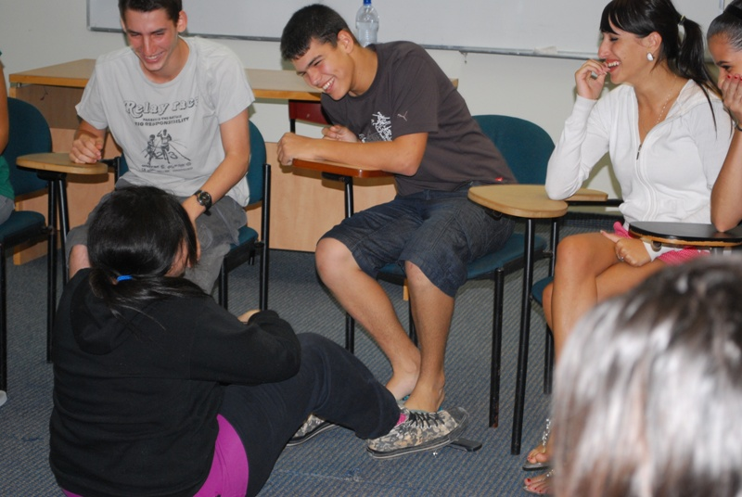
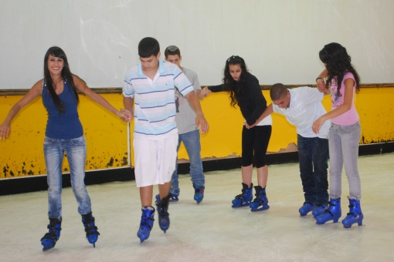
Israel - Connecting
Learning to Live Together
© Arigatou International
Notes:
Connecting: Building bridges of trust with others, moving from fear to genuine collaboration, breaking walls, unlearning
Israel citizens – Jews, Palestinians: Christian and Muslims
One week program to unlearn the different narratives they have been told, to be with “the other” for the first time, talk, try to understand the other, listen and reflect. A challenging experience to connect with that “other”, its being described as their “enemy”.

Slide 18
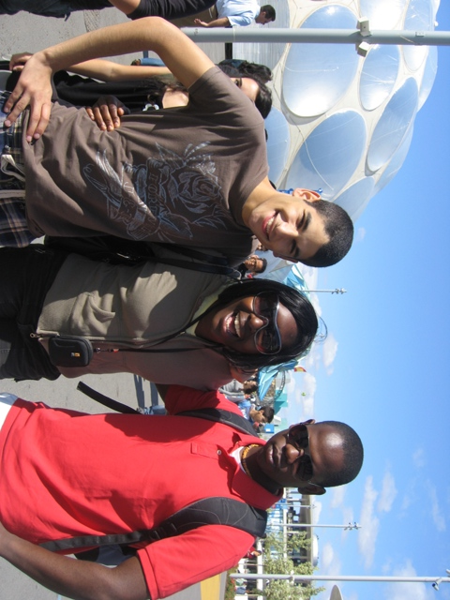
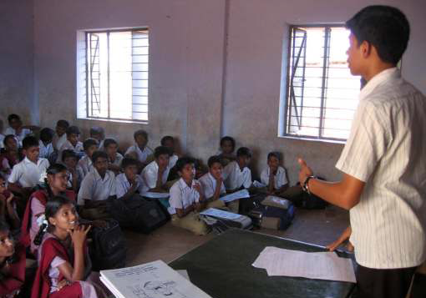
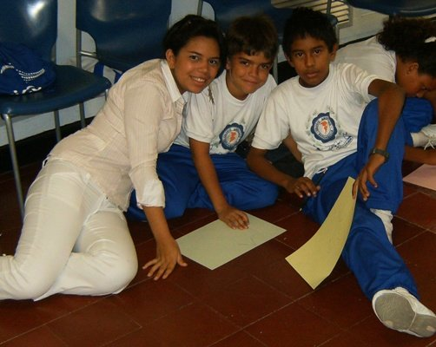
India, Colombia and Belgium –
Becoming
Learning to Live Together
Notes:
Becoming: Children and youth becoming role models for others, inspiring other children, facilitating workshops on ethics education, leading by example
Becoming who they want to be with the capacity and possibility to choose, make decisions and act based on ethical values

Slide 19
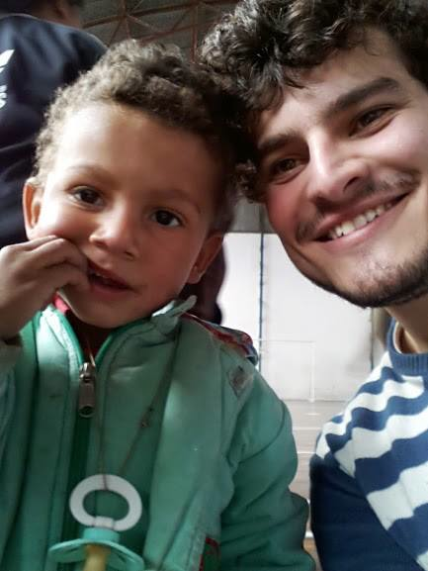
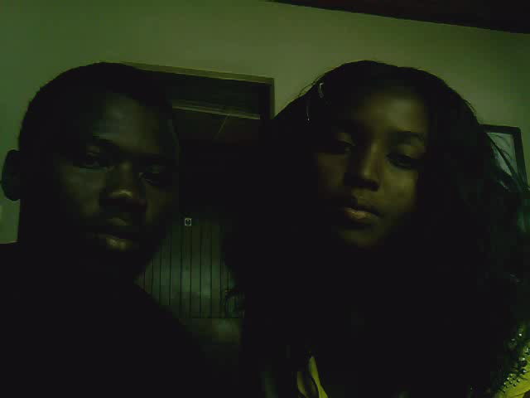
Children and youth around the world TRANSFORMING
Learning to Live Together
Notes:
Transforming: Children and youth are empowered to transform their societies, to raise awareness, to mobilize other youth, to fight against poverty, violence,
Tiago in Brazil working with parents and children on ethics education
Fadhili in Tanzania – project to compose songs to raise awareness about violence against children in the country and mobilize children and youth from the peace clubs to make a difference.
Youth in Bosnia and Herzegovina promoting interfaith dialogue

Slide 20
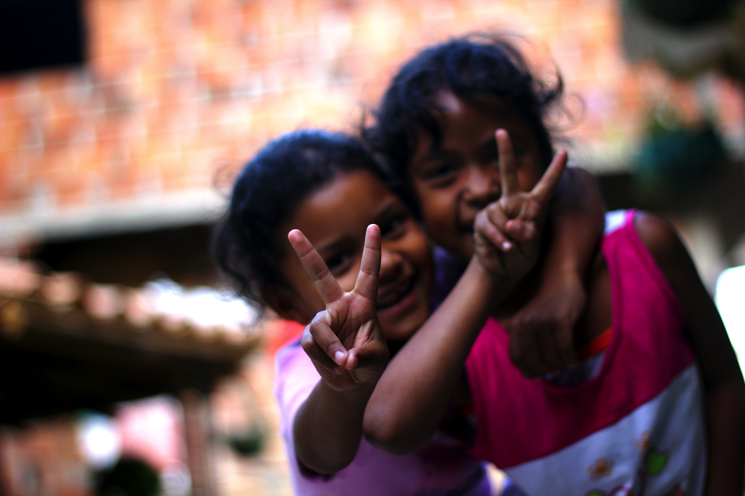
Children and Youth’s participation and Safe environment
Learning to Live Together
Safety as a promoter of the full development of the child and as a leverage to foster the participation of children in the promotion of safe environments
Notes:
By creating full “safe” environments for children and youth will allow them to thrive in confidence, to fully participate and become partners in the development and transformation of their societies.

Slide 21
Learning to Live Together
Your children are not your children.
They are the sons and daughters of Life’s longing for itself.
They come through you but not from you,
And though they are with you, yet they belong not to you.
You may give them your love but not your thoughts,
For they have their own thoughts.
You may house their bodies but not their souls,
For their souls dwell in the house of tomorrow,
which you cannot visit, not even in your dreams.
You may strive to be like them, but seek not to make them like you,
For life goes not backward nor tarries with yesterday...
Khalil Gibran
Notes:
Khalil Gibran,
The Prophet
, Chapter entitled: Children, Arrow Books Ltd, New York, 1991.
We may want to protect children from any damage but we also need to be aware that they don’t belong to us and that creating a safe environment for them goes beyond a protection perspective, we should create a safe environment that allows them to develop fully.

